Slide 1
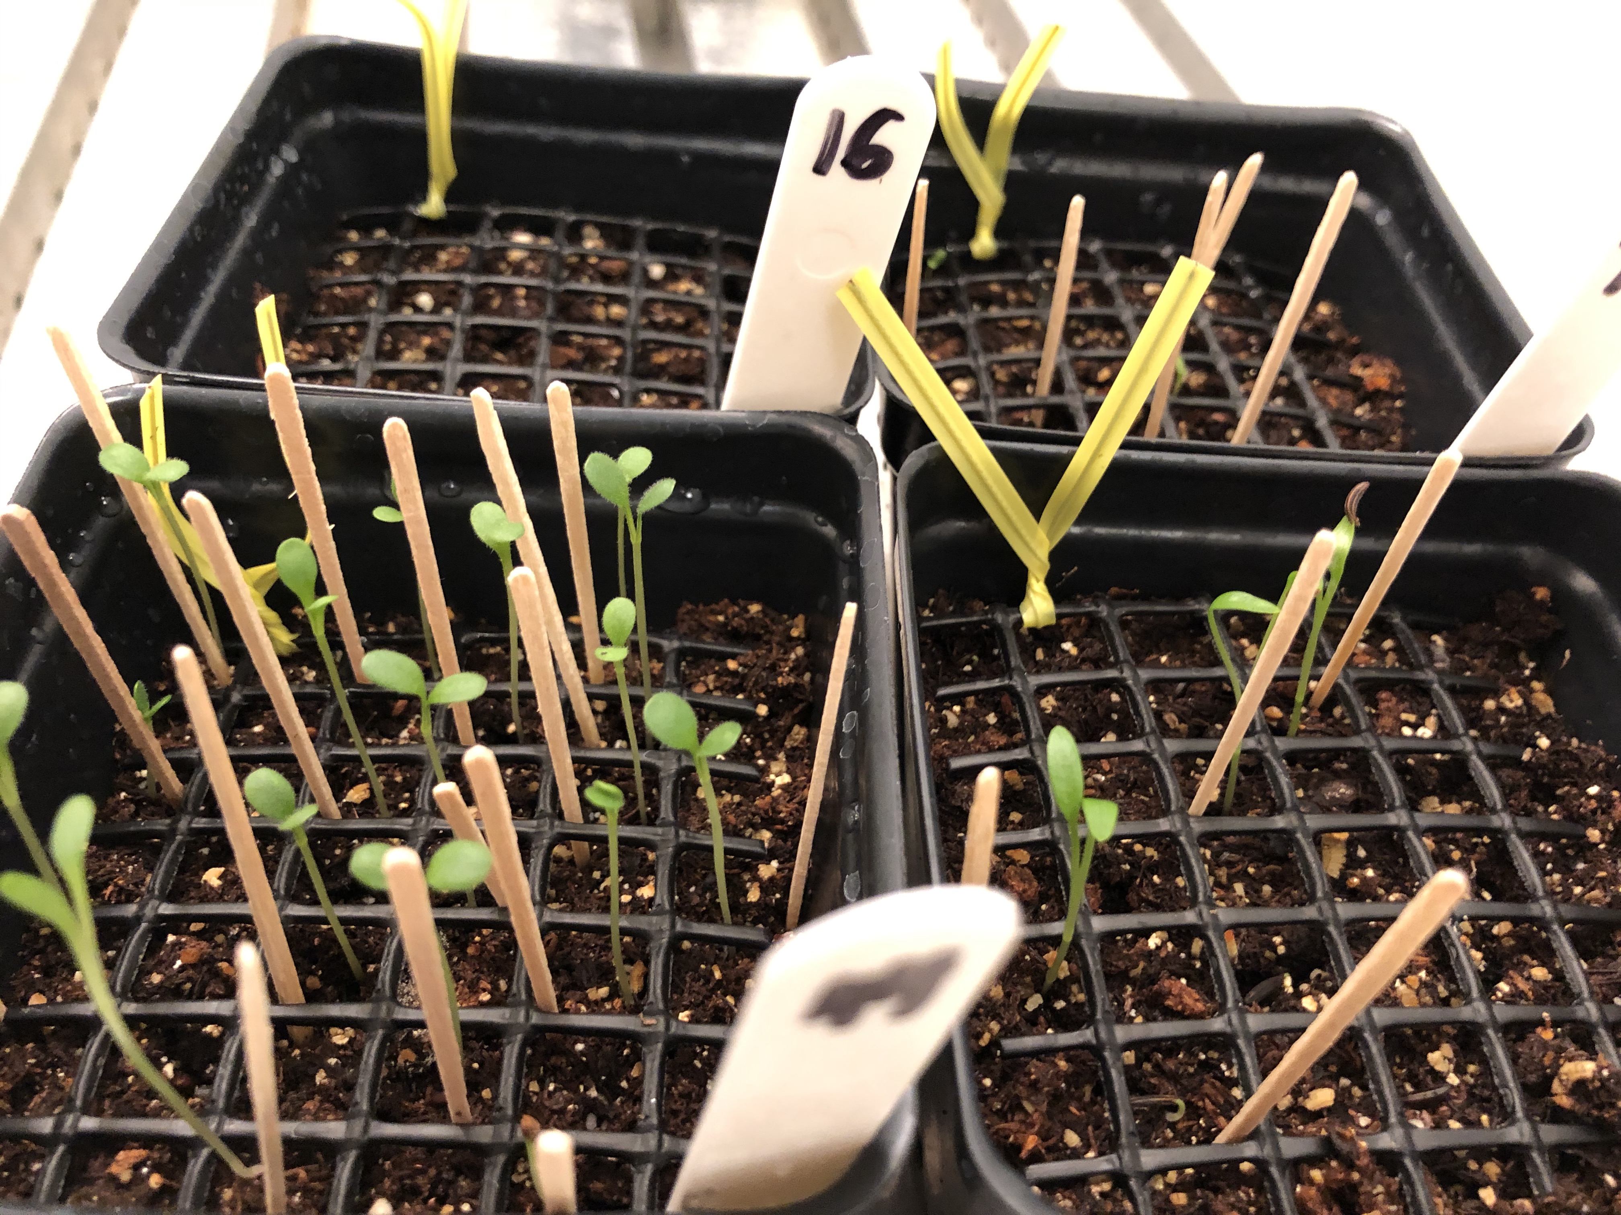
DAC 2021
Dan Buonaiuto
January 21, 2021

Slide 2
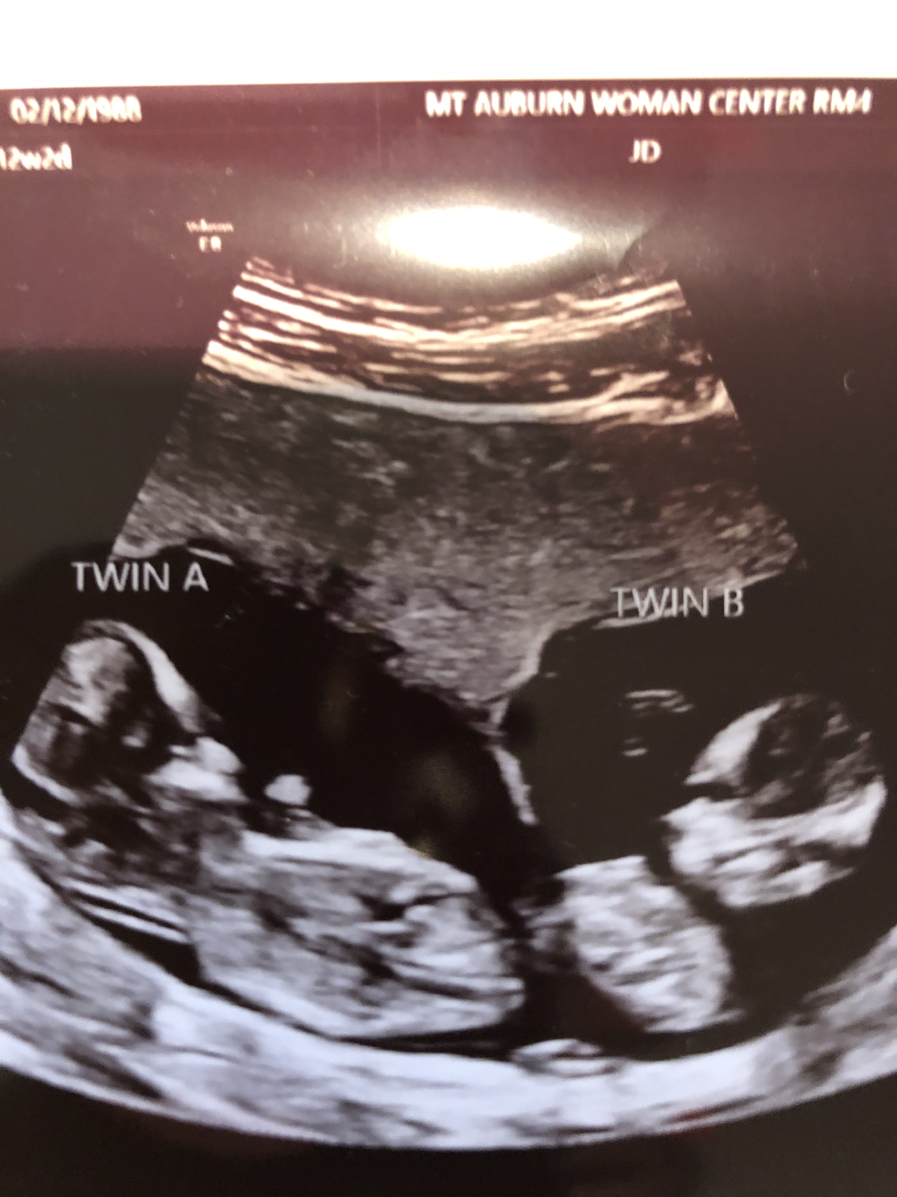
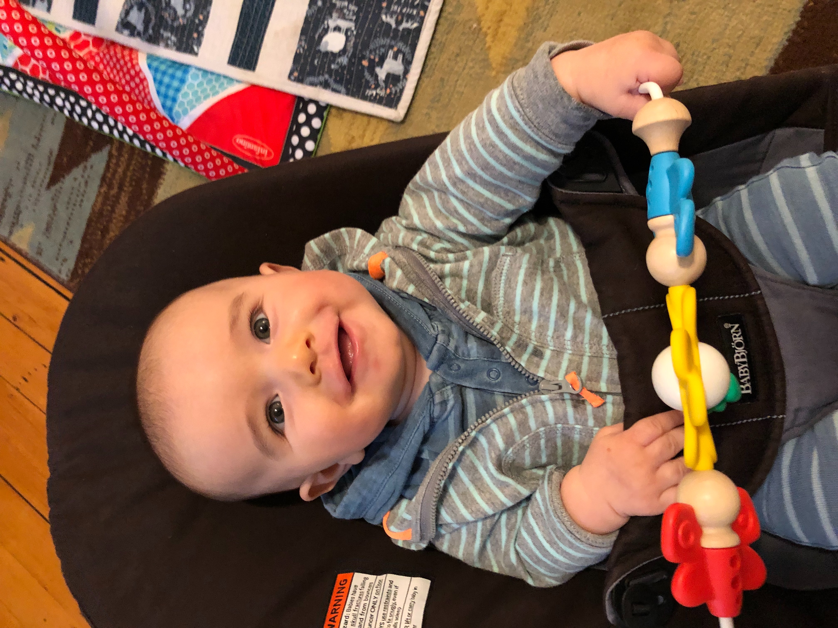
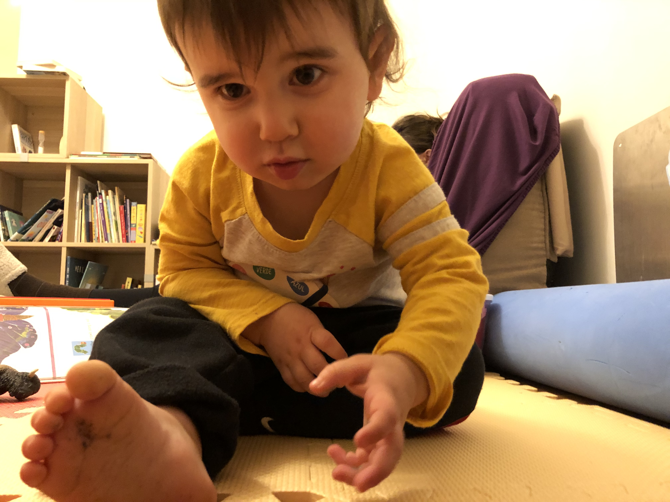
Last DAC Fall 2020

Slide 3
Phenological sensitivity as a mediator of plant performance and community interactions
Flower-leaf sequence (FLS) variation in temperate woody plants
Germination phenology of herbaceous forest species under varying climates
Brief conceptual review and recap of chapters 1 & 2
Progress update on chapters 3 & 4
Timeline

Slide 4
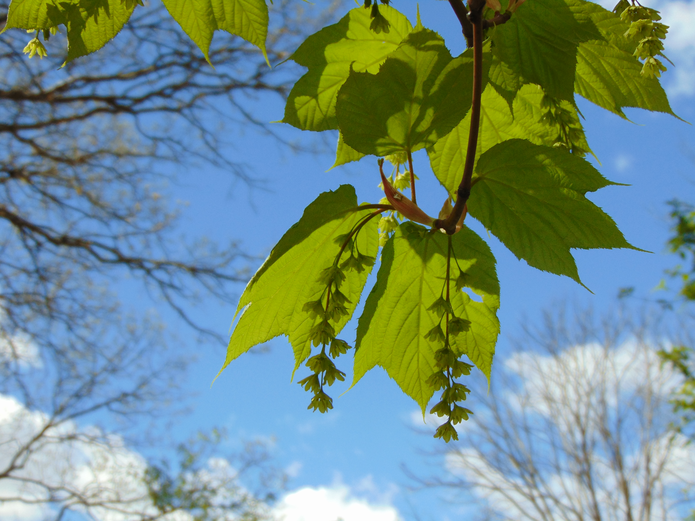
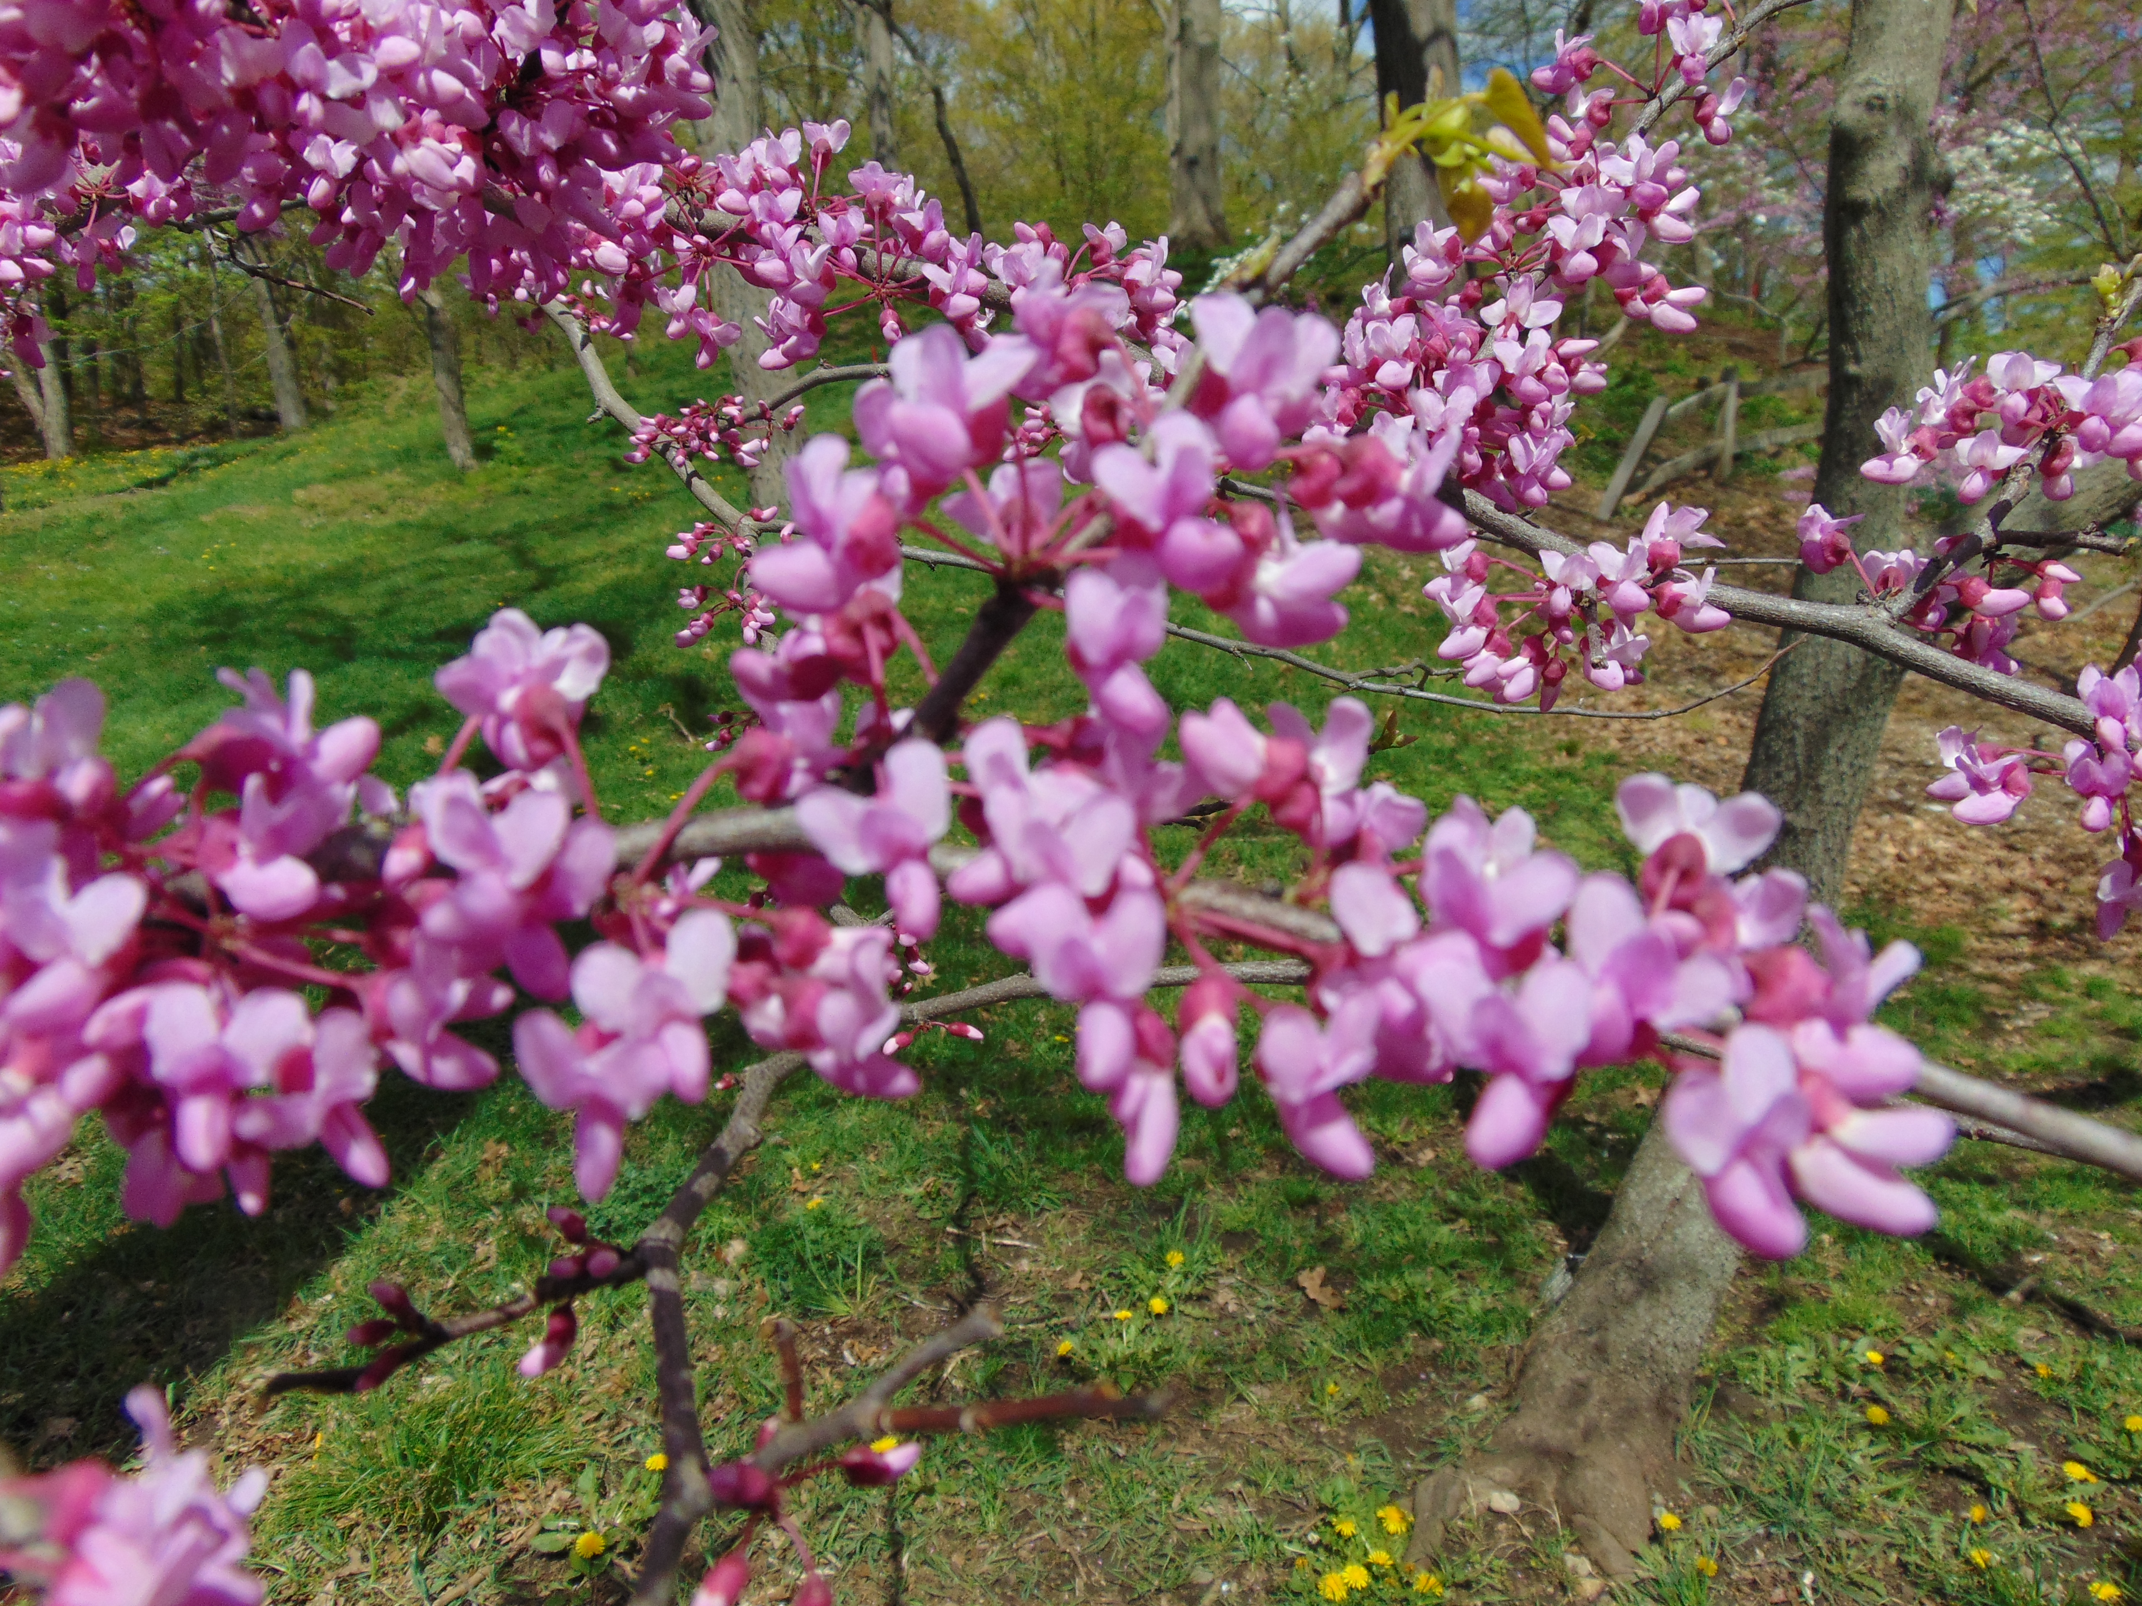
FLS recap:
Seranthy
Synanthy
Hysteranthy
Notes:
Major part of my dissertation evolutionary drivers and ecological consequences of hysteranthy

Slide 5
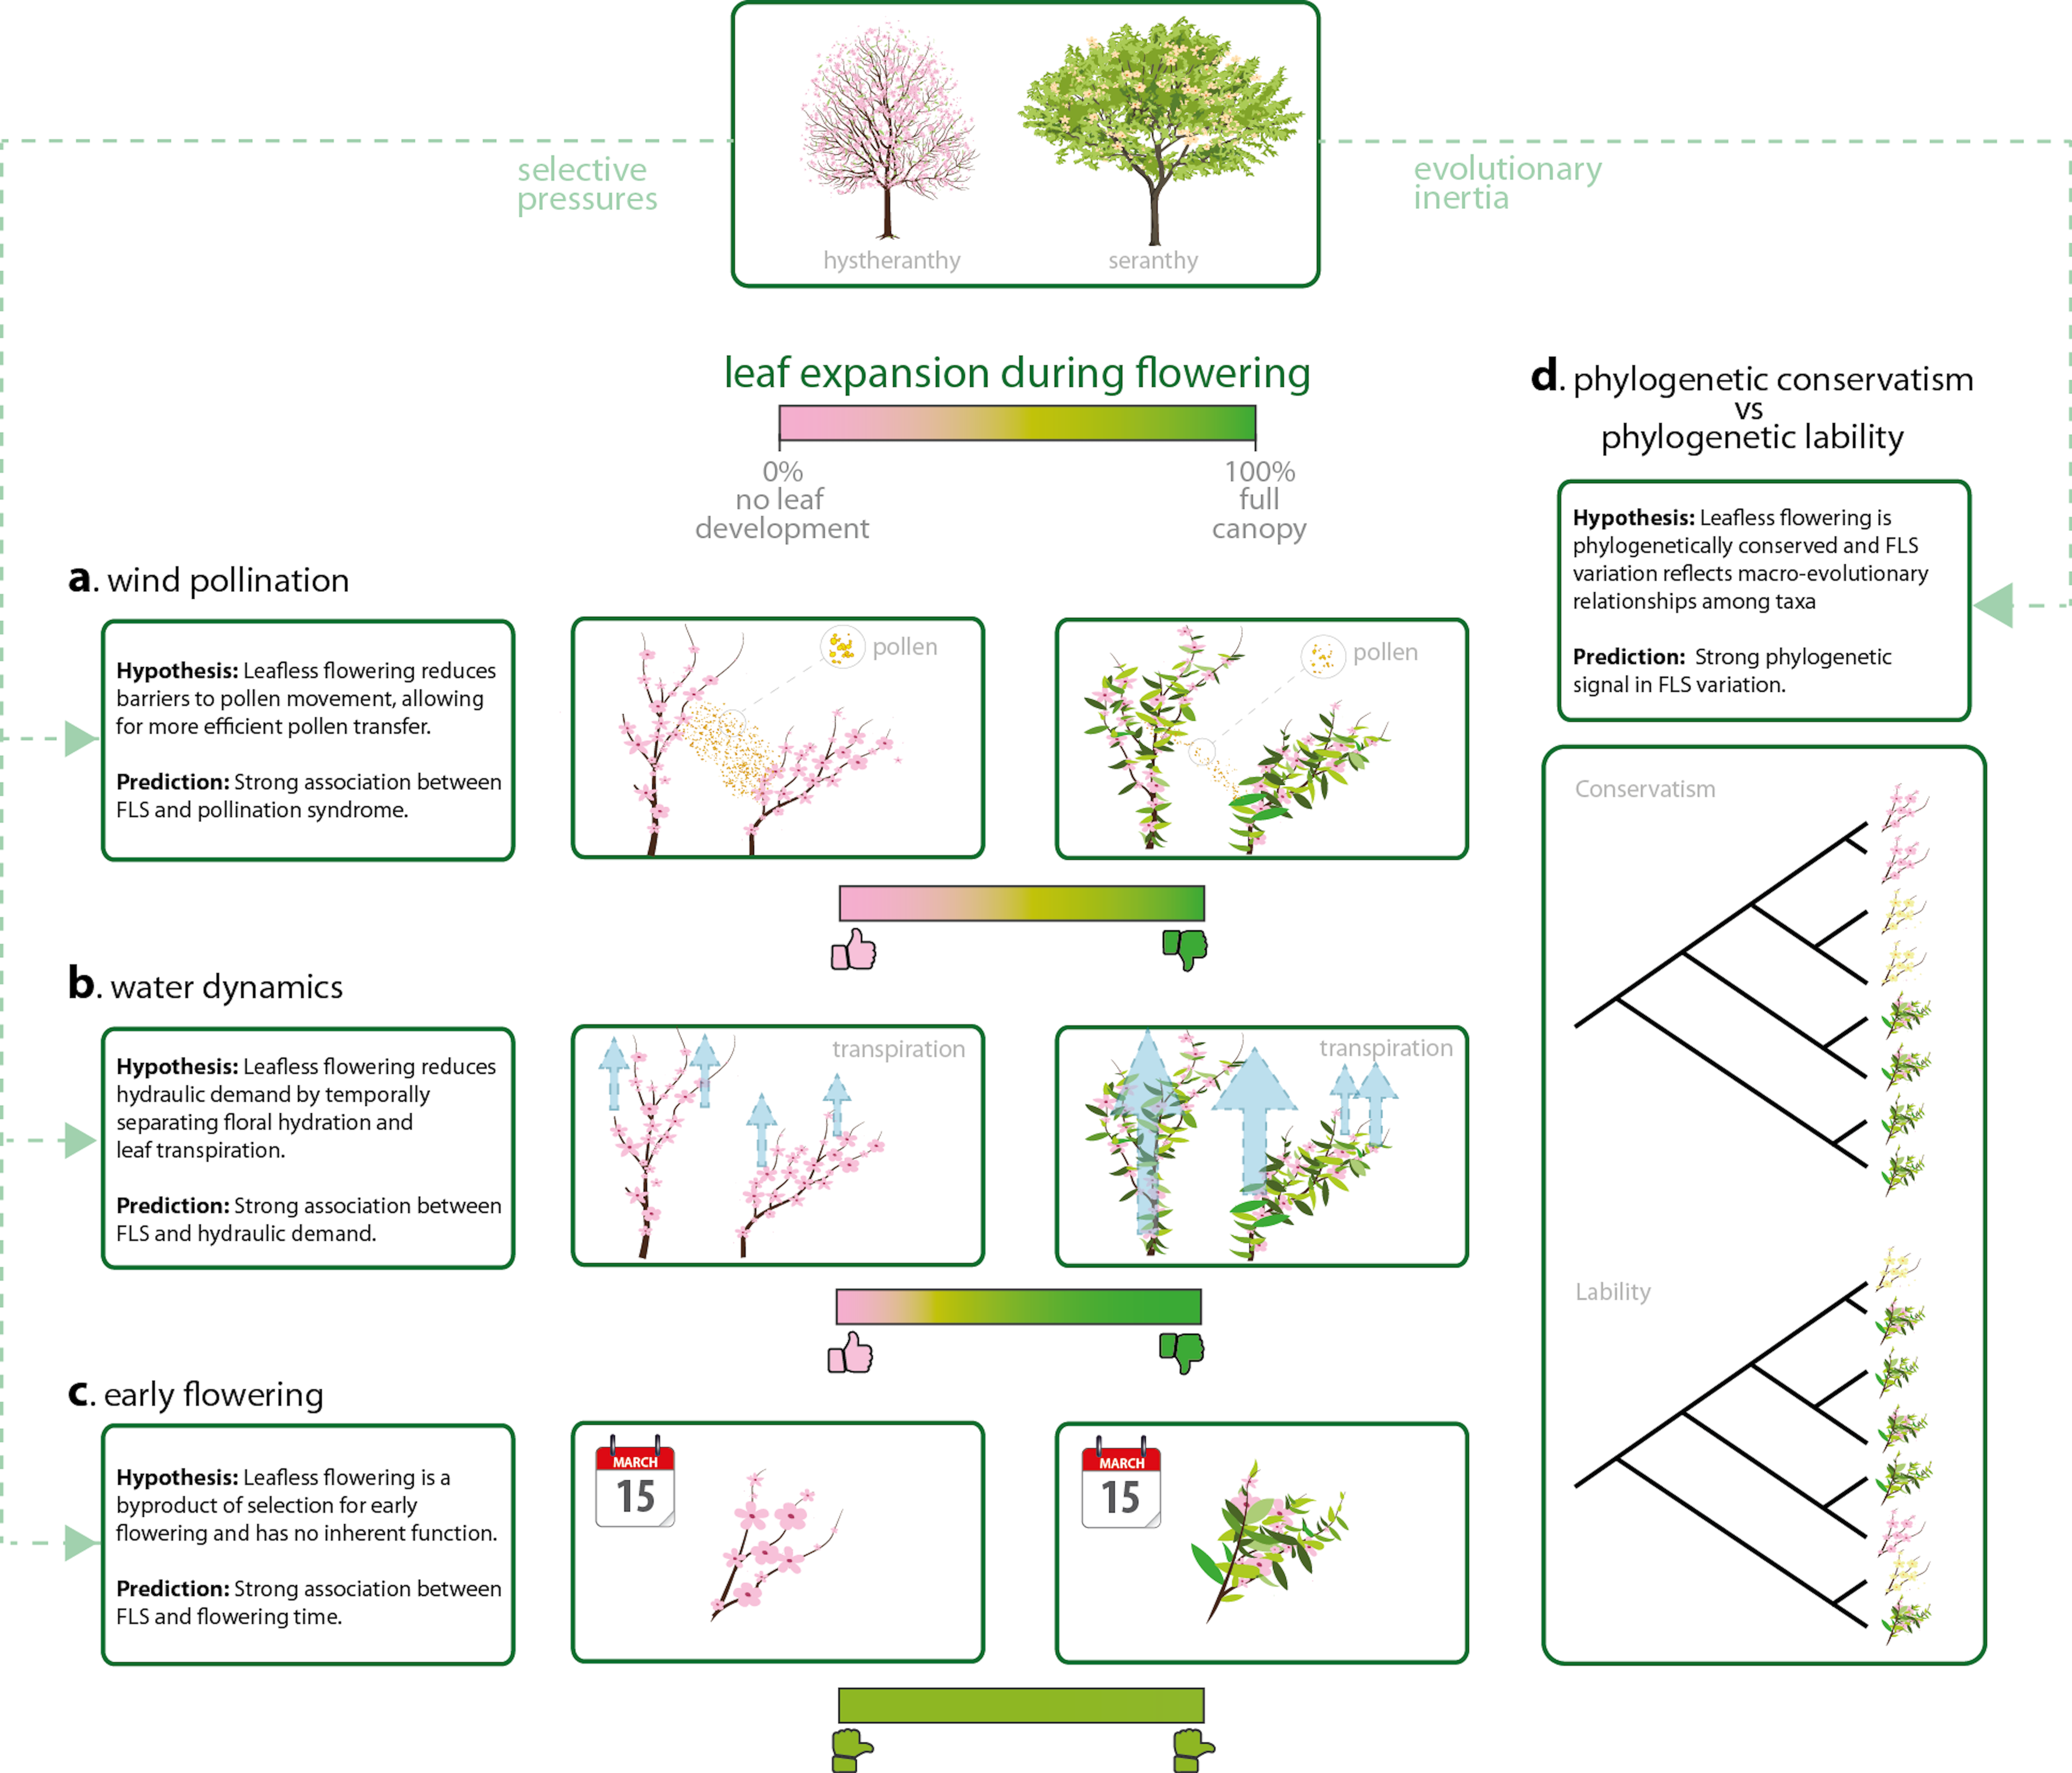
Buonaiuto et al 2020
Notes:
Water dynamics-> free tolerannce

Slide 6

Chapter 1: Reconciling competing hypotheses regarding flower-leaf sequences in temperate forests for fundamental and global change biology New Phytologist, 2021

Slide 7
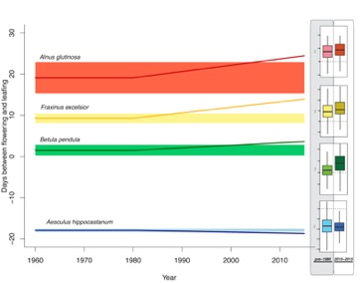
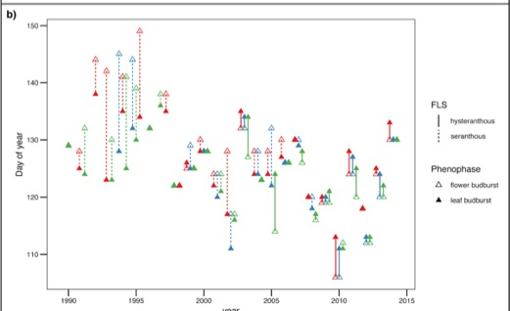

Slide 8
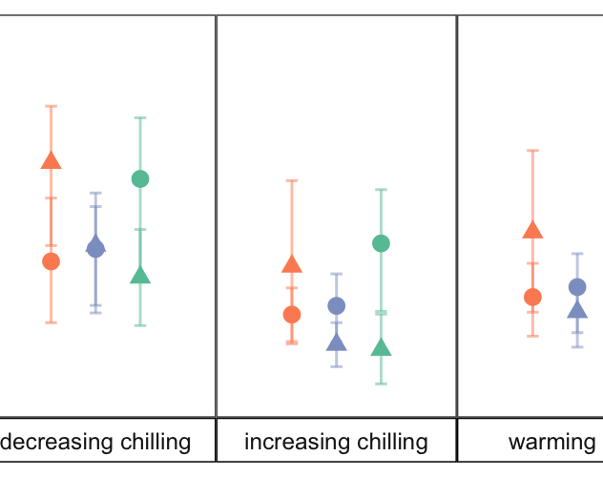
Chapter 2: Differences in flower and leaf bud environmental responses drive shifts in spring phenological sequences of temperate woody plants Submitted to Journal of Ecology, December 2020

Slide 9

Chapter 1
FLS variation
Chapter 2
Environmental variation and species interactions
FLS variation
Chapter 3: Drivers of FLS variation in insect pollinated taxa
Chapter 4:
Seasonal priority effects on plant competition

Slide 10
FLS variation in Prunus ssp. Prunus sect. Prunocerasus; The American Plums
Insect pollinated!
Within section FLS variation at the species level.
Similar inflorescence morphology
Published phylogenies
Part I: characterize FLSs
Part II: FLSs and traits
Part III: FLS shifts with climate change

Slide 11
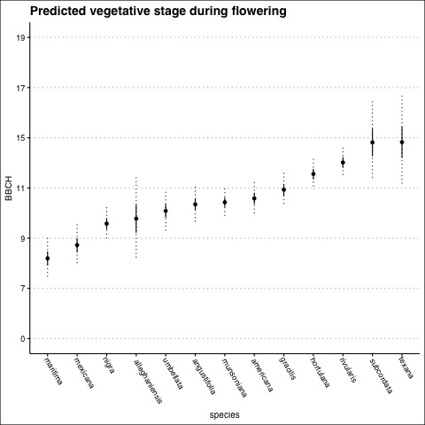
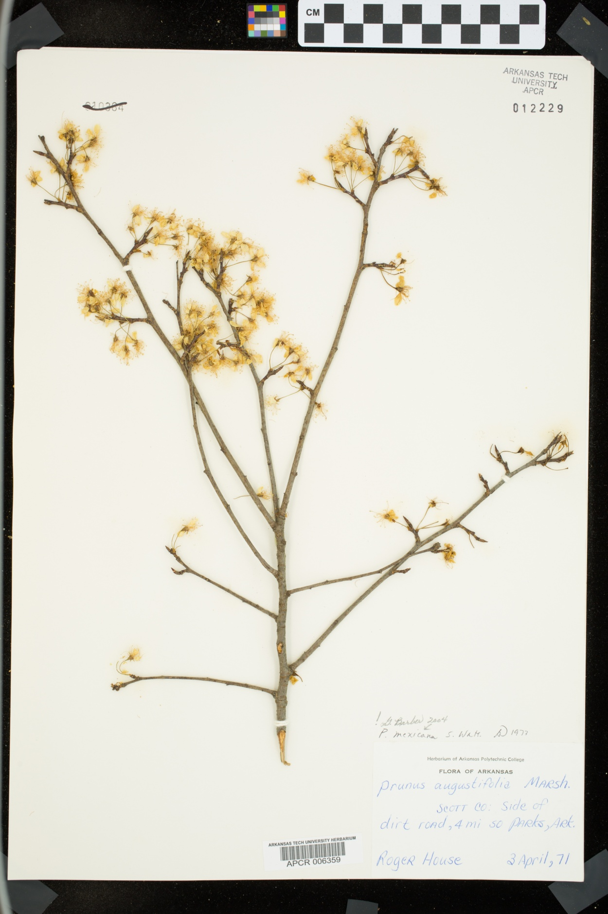
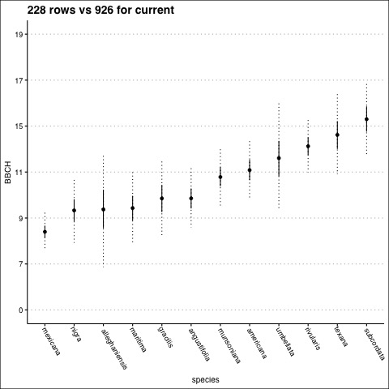
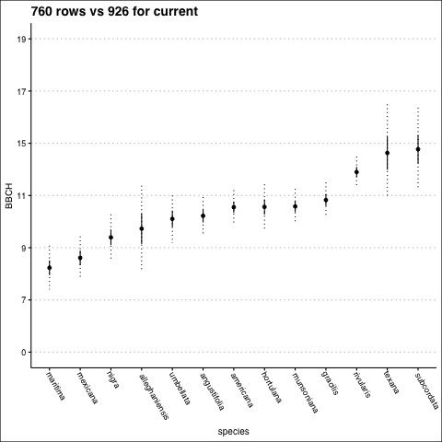
Scored 2,305 herbarium specimens
Notes:
Could add unlimmited of some species eg americana, but other are already maxed out eg texana

Slide 12
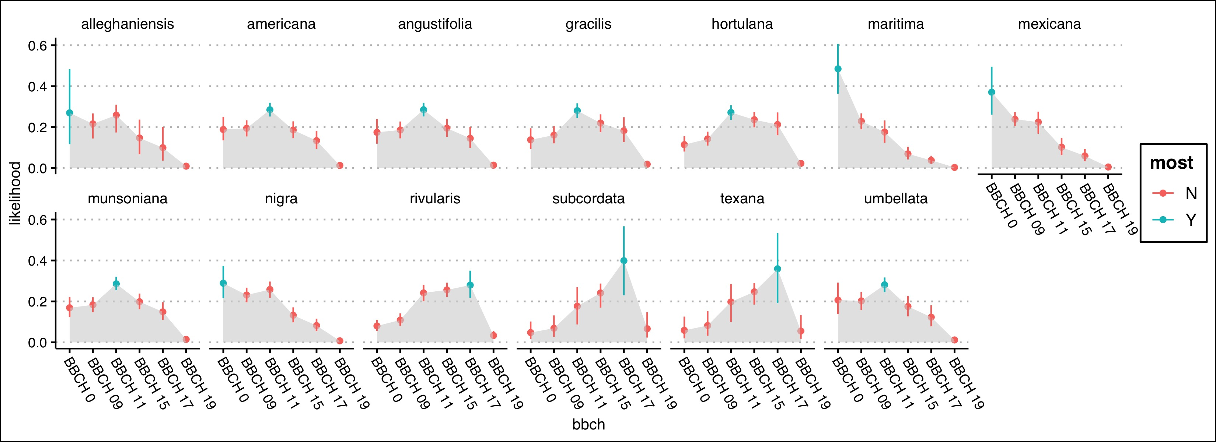
Notes:
Why pruncerasus ? All considered flower before flower before/with and flower with– different sources score differently

Slide 13
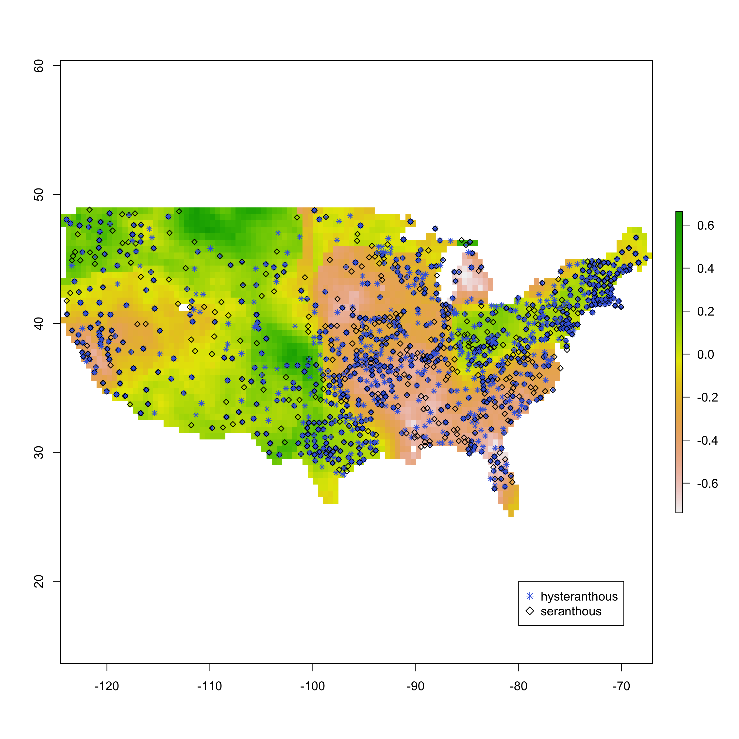
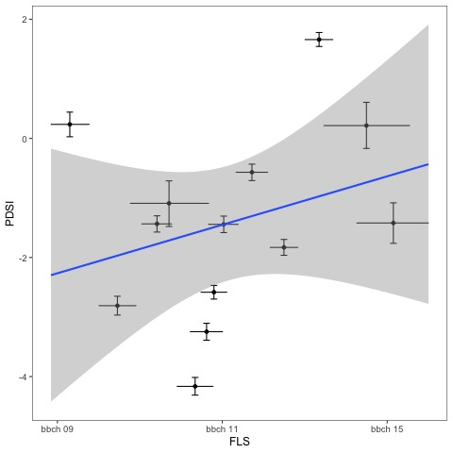
Next steps
1. Model selection
2. Use joint modeling to test for relationships between species level FLS distribution and other ecological/functional traits relevant to FLS hypotheses
PDSI (drought tolerance hypothesis)
Petal length (insect visibility hypothesis)
Fruit size (early flowering hypothesis)
Min. temperature (drought-> frost tolerance)
Phylogeny

Slide 14
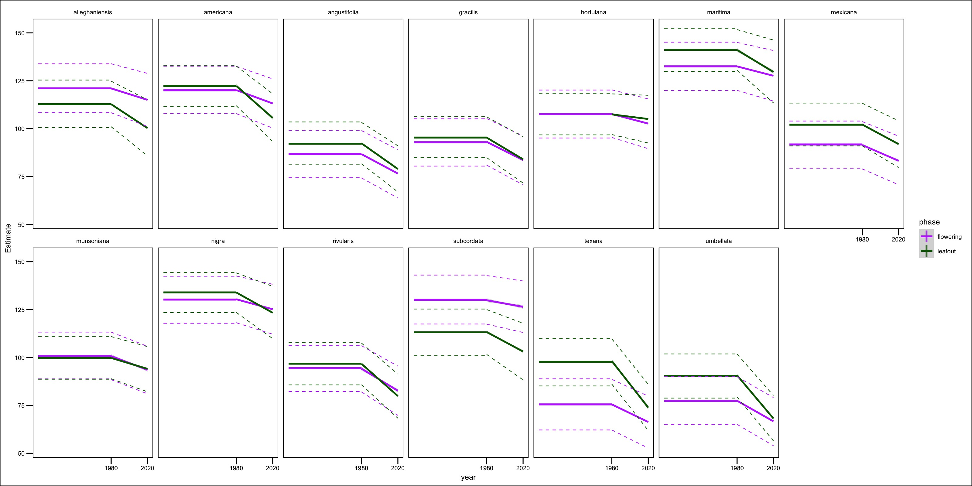
Climate Change impacts of FLSs in the American plums

Slide 15
Seasonal Priority effects
Evidence that earlier germinates gain competitive dominance through priority advantage
Caveats: determined largely through sequential planting experiments (irrelevant to species with dormancy)
Only grassland species
Does germination rank vary enough due to climate response to generate priority effects?

Slide 16
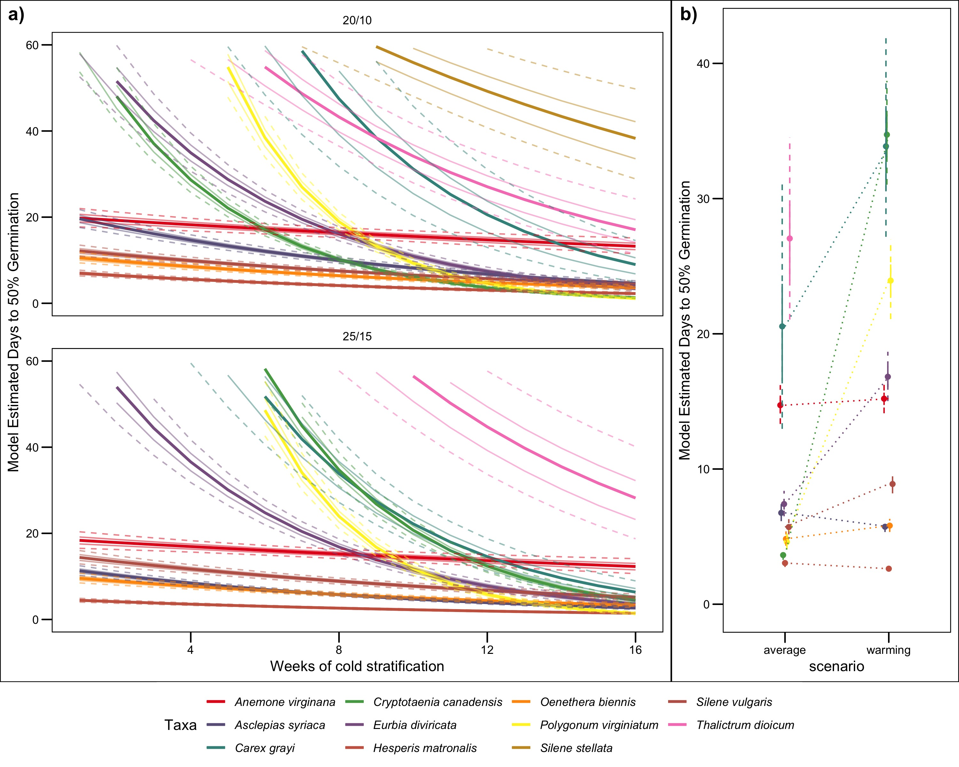
Pilot study:
It seems like yes, but do these germination differences actually impact competition?

Slide 17
Response surface competition trial:
3 species (pairwise) C. canadensis, H. matronalis*, P. virginiatum
3 replicates of:
14:0, 10:4 7:7. 4:10 ,0:14
8:0,6:2, 4:4, 2:6 0:8
2 stratification treatments ( 11 and 7 weeks)
2 harvest dates ( 4 and 10 weeks after germination period (20 days))

Slide 18
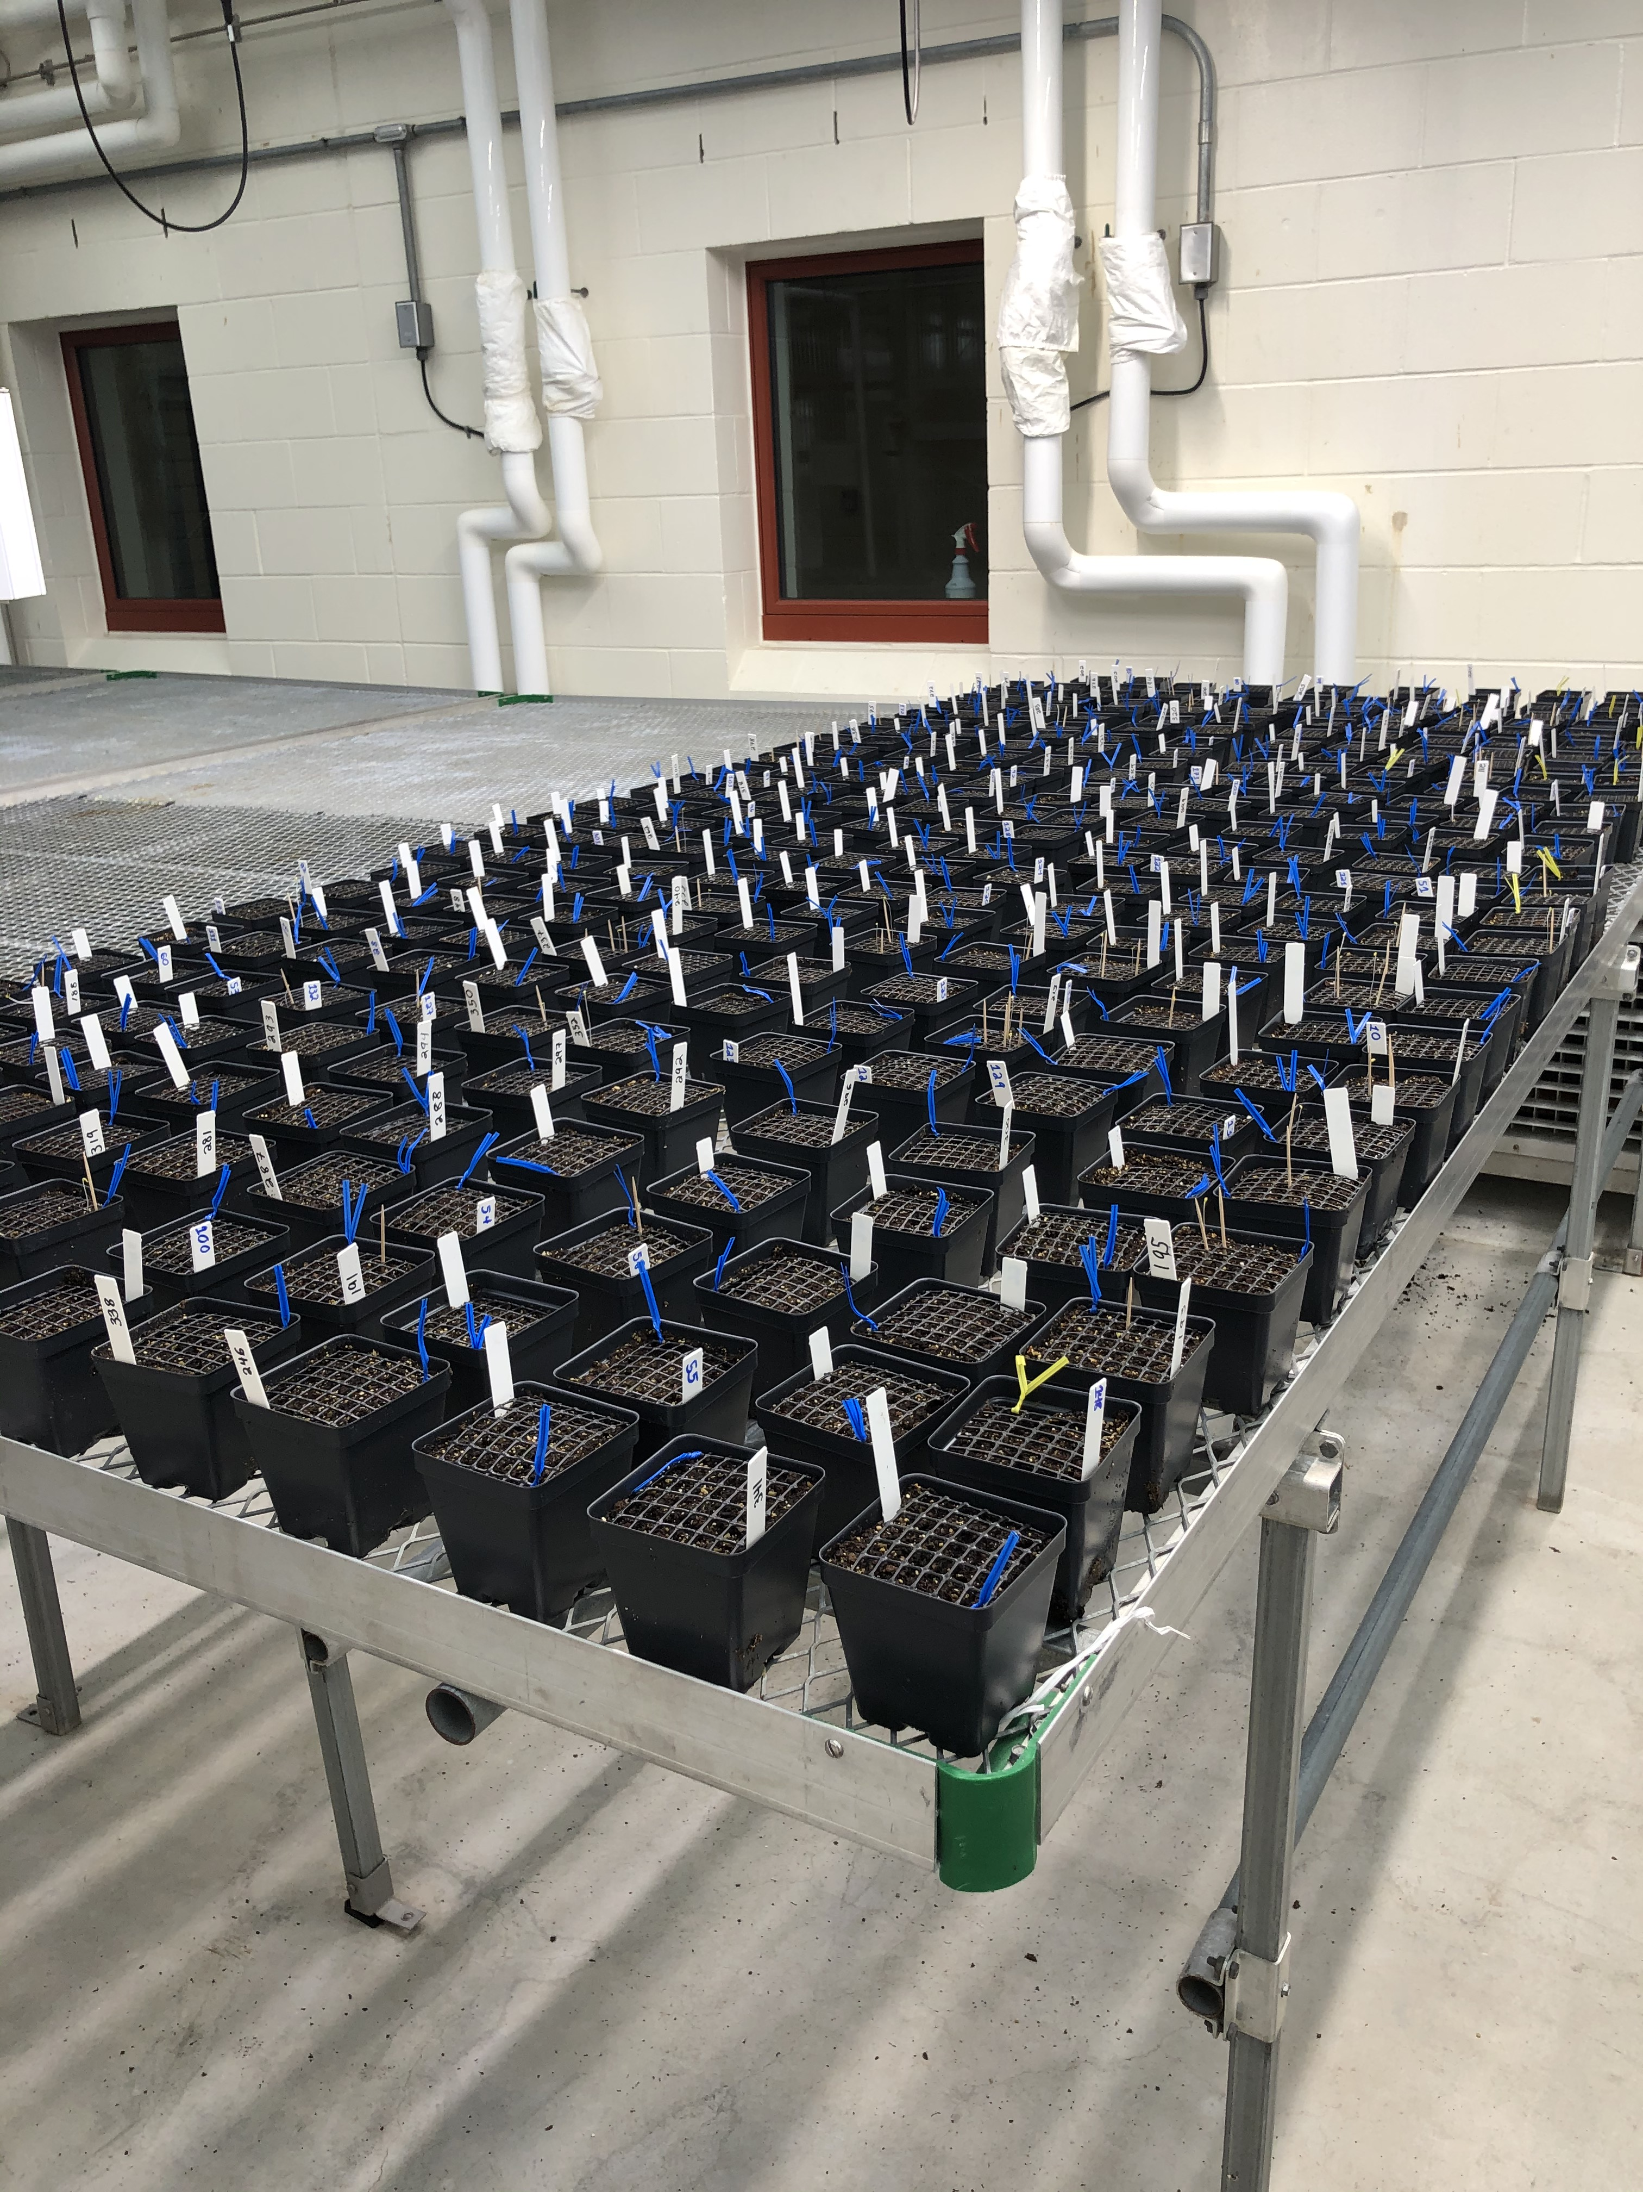
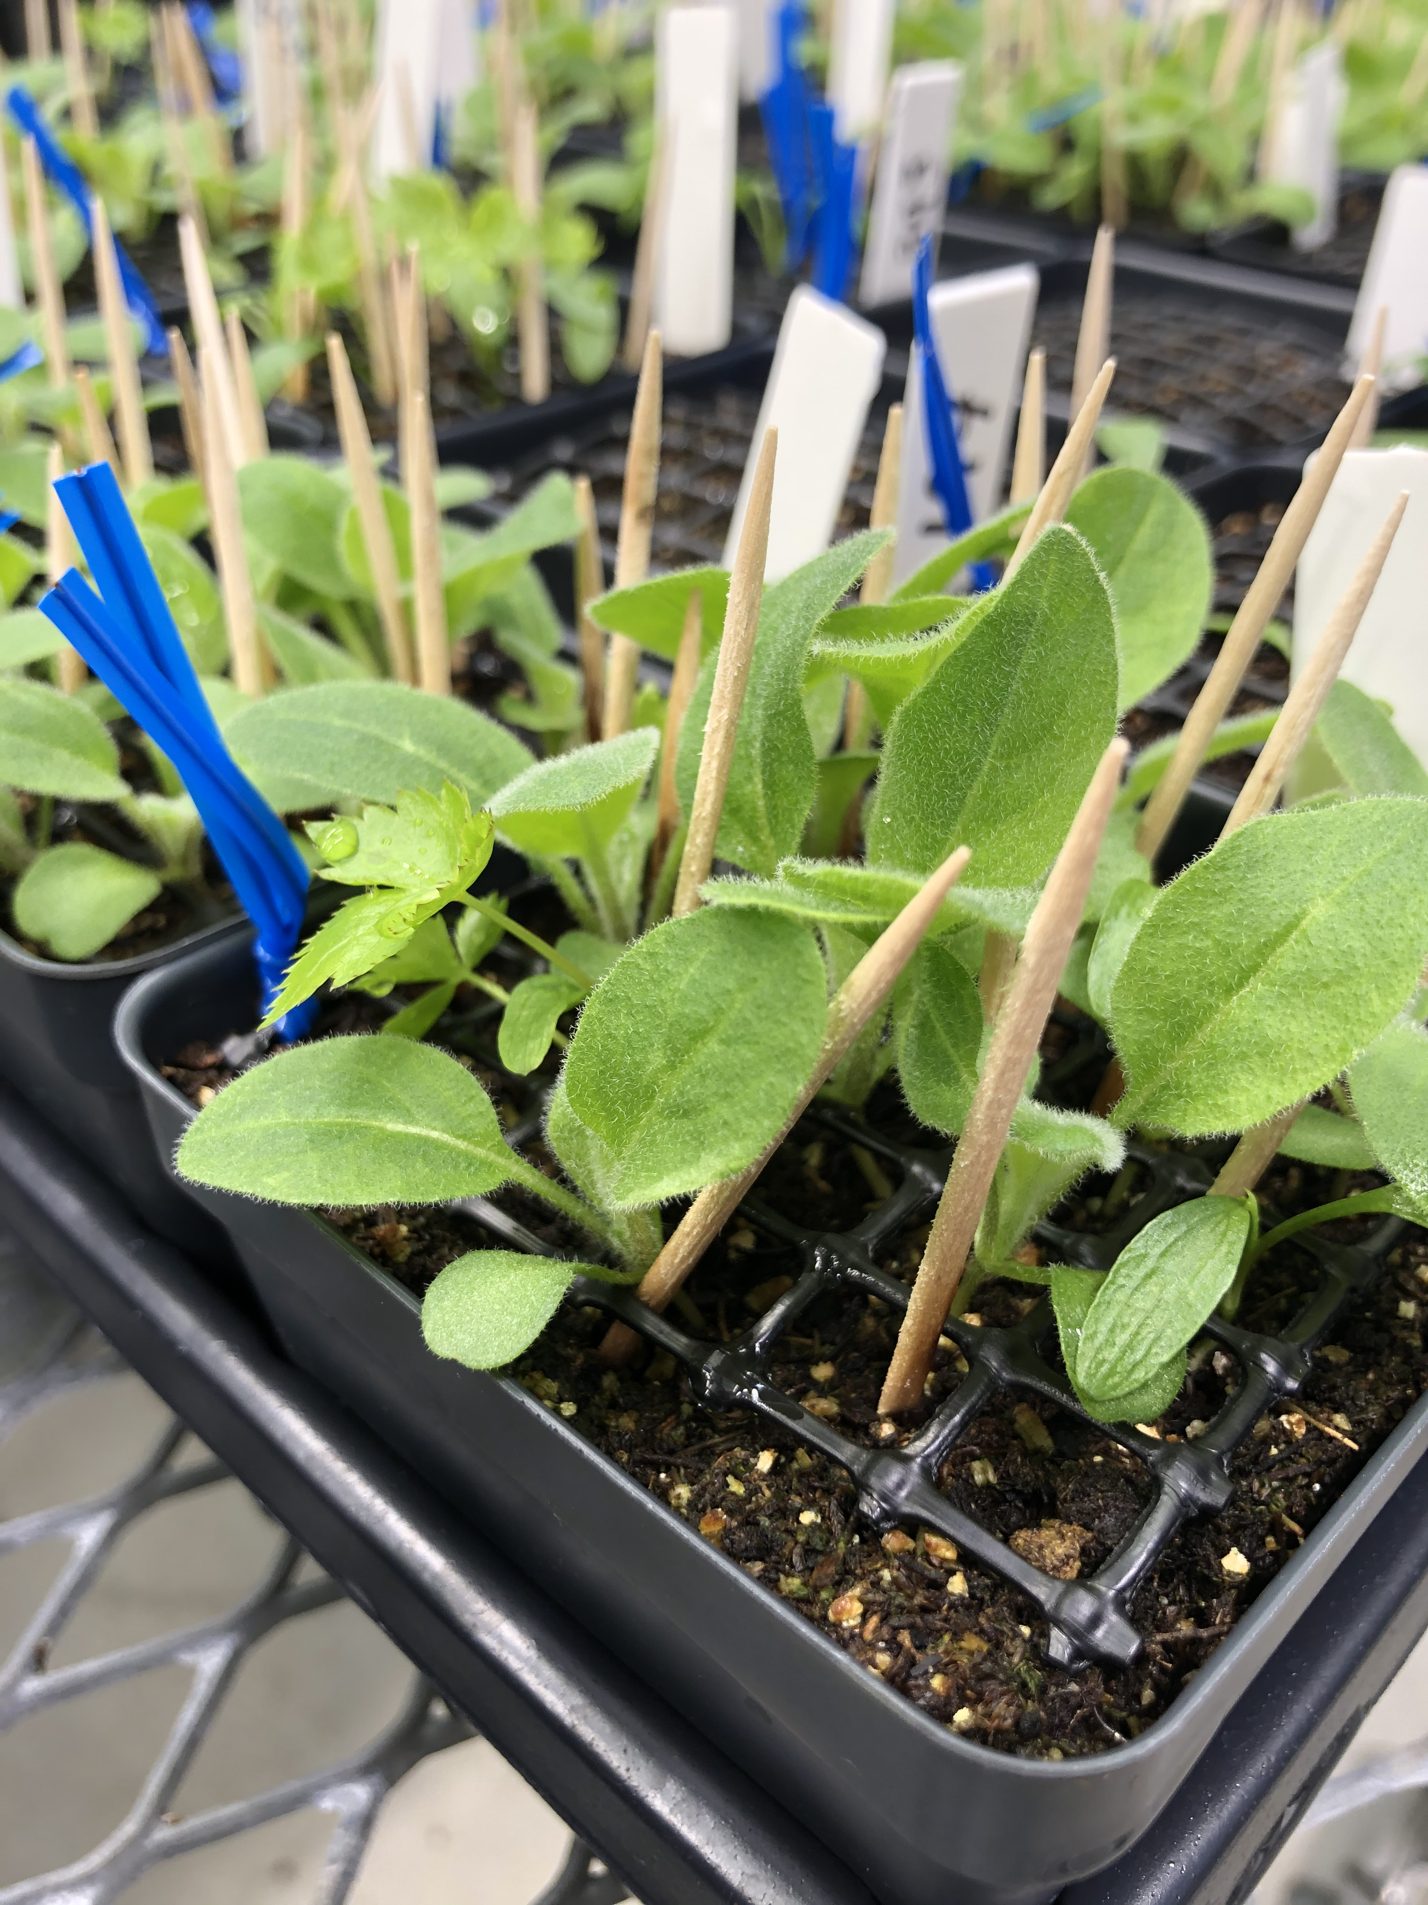
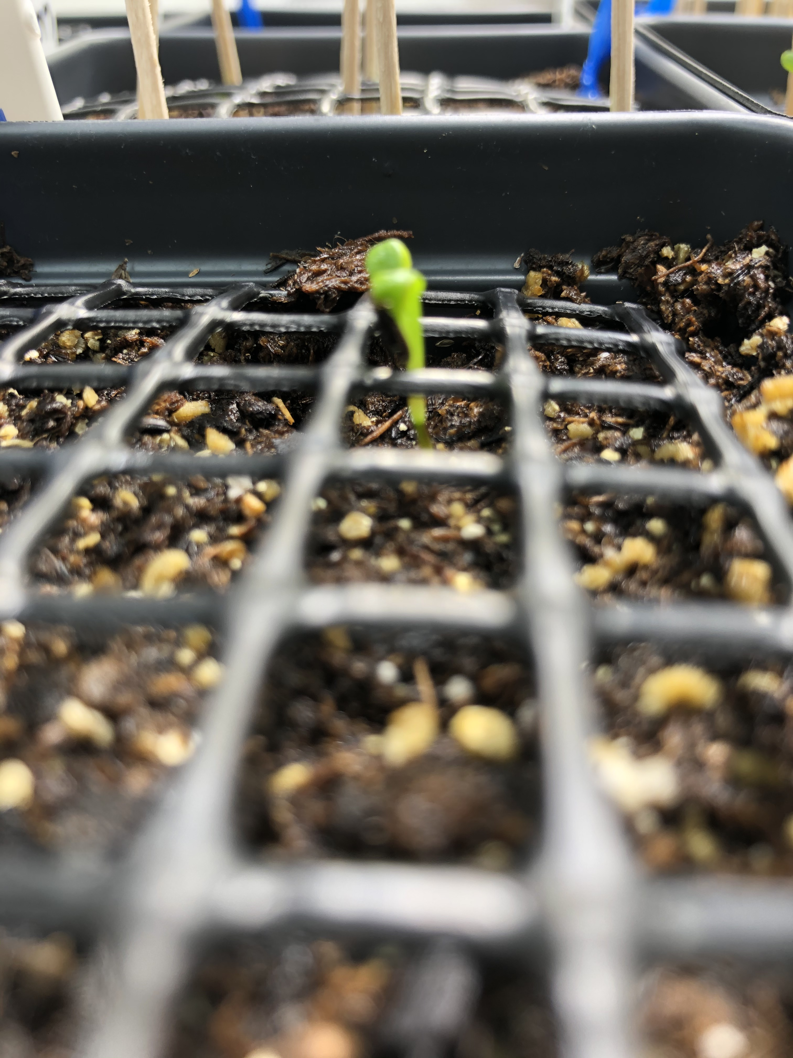

Slide 19
Steps
Monitor phenology (to quantify priority) (completed 15 Jan)
Harvest and Biomass (above ground) plants (Feb, March)
Modeling (Fall 2021)

Slide 20
On the side:
OSPREE (Collaboration with the Wolkovich lab):
2 published manuscripts
2 in prep
2-3 in the works
1 lead author Spring 2021
Common Garden: (collaboration with Cat Chamberlain)
Growing season observation from 2016-2020
Paper in the works
Photo vs. Thermo-periodicity
In the works

Slide 21

Complete petal measurements
Construction working joint model
Write and submit plum paper
Data analysis for SPE project
Write up SPE
Perform phenological analysis
Complete all experimental tasks
Write up dissertation
Defend dissertation
TF OEB 399, 137 or ideally, exemption
TF OEB 55
Write OSPREE ranges manuscript
Spring 2021
Summer 2021
Fall 2021
Spring 2022

